Slide 1
Probability of Upper Cutoff Point
0856706 Susan Ku

Slide 2
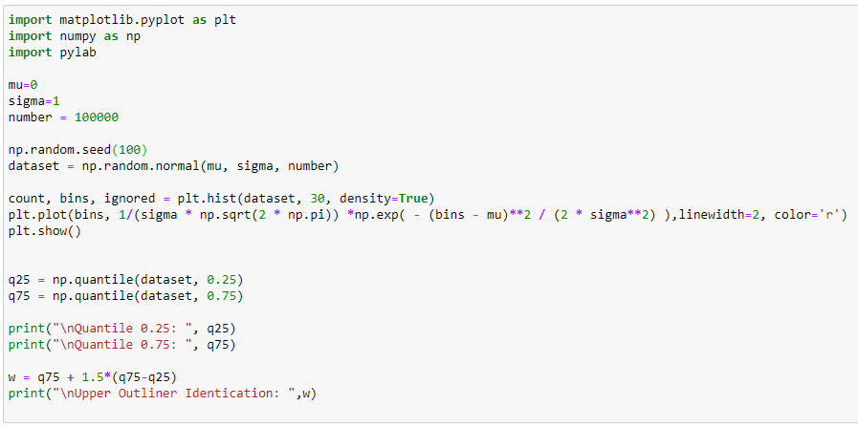
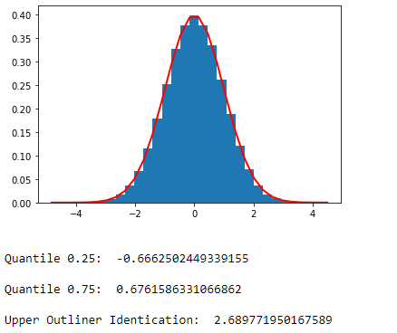
Calculate Quantile for Normal Distribution
Quantile_normal.ipynb

Slide 3
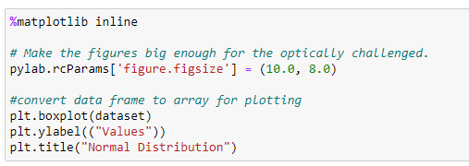
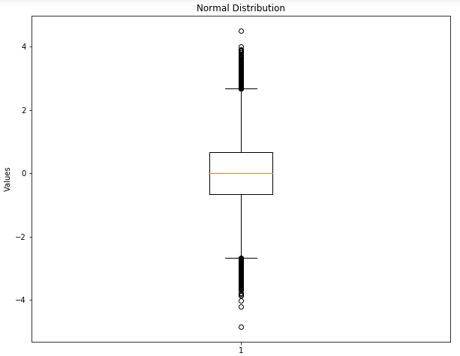
Plot Box
Quantile_normal.ipynb

Slide 4
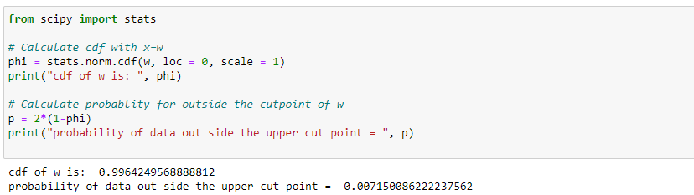
Calculate Probability
Quantile_normal.ipynb

